Slide 1
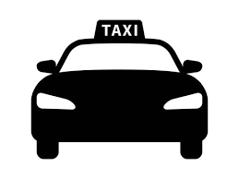
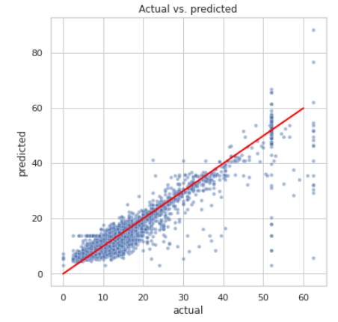
Multi-linear regression for Taxi TLC Project
Executive summary report
Commission Prepared by Automatidata team
Project Overview
The Automatidata team has reviewed the results of the A/B testing. Now it’s time to work on predicting the taxi fare amounts through a multi-linear regression model.
In order to showcase the efficacy of the linear regression model, the Automatidata data team included a scatter plot comparing the predicted and actual fare amount. This model can be used to predict the fare amount of taxi cab rides with reasonable confidence. The provided notebook exhibits further analysis on the model residuals.
The feature with the greatest effect on fare amount was ride duration, which was not unexpected. The model revealed a mean increase of $9 for each additional minute, however, this is not a reliable benchmark due to high correlation between some features.
Request additional data from under-represented itineraries.
The New York City Taxi and Limousine commission can use these findings to create an app that allows users (TLC riders) to see the estimated fare before their ride begins.
The model provides a generally strong and reliable fare prediction that can be used in downstream modeling efforts.
Alt-text: The scatter plot shows a linear regression model plot illustrating predicted and actual fare amount for taxi cab rides.
The model performance is high on both training and test sets, suggesting that the model is not over-biased and that the model is not overfit. The model performed better on the test data.
Model metrics:
Net model tuning resulted in:
R^2 0.87, meaning that 86.8% of the variance is described by the model.
MAE 2.1
MSE: 14.36
RMSE 3.8

